Slide 1

The Internet
Chris Piech
CS106A, Stanford University

Slide 2
Review

Slide 4
Mindset
Country
Has a database
Has a name
Has an array of gdps
Has an array of pops
Has an array of lifeSpans
run()
getGdp(year)
getPopulation(year)
getLifeSpan(year)
addFileLine(line)
MindsetDataBase
Has a map of countries
loadData()
getCountry(name)
getAllCountryNames()

Slide 5
Mindset
Has a database
run()

Slide 6
Mindset
Has a database
run()

Slide 7
Mindset
Has a database
run()

Slide 8
Mindset
Country
Has a database
Has a name
Has an array of gdps
Has an array of pops
Has an array of lifeSpans
run()
getGdp(year)
getPopulation(year)
getLifeSpan(year)
addFileLine(line)
MindsetDataBase
Has a map of countries
loadData()
getCountry(name)
getAllCountryNames()

Slide 9
MindsetDataBase
Has a map of countries
loadData()
getCountry(name)
getAllCountryNames()

Slide 10
MindsetDataBase
Has a map of countries
loadData()
getCountry(name)
getAllCountryNames()

Slide 11
MindsetDataBase
Has a map of countries
loadData()
getCountry(name)
getAllCountryNames()

Slide 12
MindsetDataBase
Has a map of countries
loadData()
getCountry(name)
getAllCountryNames()

Slide 13
MindsetDataBase
Has a map of countries
loadData()
getCountry(name)
getAllCountryNames()

Slide 14
Mindset
Country
Has a database
Has a name
Has an array of gdps
Has an array of pops
Has an array of lifeSpans
run()
getGdp(year)
getPopulation(year)
getLifeExpectancy(year)
addFileLine(line)
MindsetDataBase
Has a map of countries
loadData()
getCountry(name)
getAllCountryNames()

Slide 15
Country
Has a name
Has an array of gdps
Has an array of pops
Has an array of lifeSpans
getGdp(year)
getPopulation(year)
getLifeExpectancy(year)
addFileLine(line)

Slide 16
Country
Has a name
Has an array of gdps
Has an array of pops
Has an array of lifeSpans
getGdp(year)
getPopulation(year)
getLifeExpectancy(year)
addFileLine(line)

Slide 17
Country
Has a name
Has an array of gdps
Has an array of pops
Has an array of lifeSpans
getGdp(year)
getPopulation(year)
getLifeExpectancy(year)
addFileLine(line)

Slide 18
Country
Has a name
Has an array of gdps
Has an array of pops
Has an array of lifeSpans
getGdp(year)
getPopulation(year)
getLifeExpectancy(year)
addFileLine(line)

Slide 19
End Review

Slide 20
I came here to learn to program the internet...

Slide 22
For the third time ever in CS106A:

Slide 23

Learning Goals
Write a program that can make internet requests
Write a program that can respond to internet requests

Slide 24
How does your phone communicate with facebook?

Slide 25
The Java program on your phone talks to the Java program at Facebook

Slide 26
Face Book Server
* Android phones run Java. So do facebook servers

Slide 27
Face Book Server
Is this legit?
piech@cs.stanford.edu
piech@cs.stanford.edu is now logged in

Slide 28
Face Book Server
Send me the full name for
piech@cs.stanford.edu
Chris Piech
“Chris Piech”

Slide 29
Face Book Server
Send me the cover photo for
piech@cs.stanford.edu
Chris Piech

Slide 30
Face Book Server
Send the profile photo for
piech@cs.stanford.edu
Chris Piech

Slide 31
Face Book Server
Send the status for
piech@cs.stanford.edu
Chris Piech
“chillin”
Status: Chris is chillin
Set status:

Slide 32
Face Book Server
Set the status for
piech@cs.stanford.edu
to be “lecturing”
Chris Piech
“success”
Status: Chris is chillin
Set status:
lecturing

Slide 33
Face Book Server
Send me the status for
piech@cs.stanford.edu
Chris Piech
“lecturing”
Status: Chris is chillin
Status: Chris is lecturing
Set status:

Slide 34
Background: The Internet
The internet is just many programs sending messages (as Strings)
Thanks Nick for the teaching YEAH

Slide 35
Background: The Internet
Facebook datacenter
Your computer (facebook.com)
The internet is just many programs sending messages (as Strings)
Thanks Nick for the teaching YEAH

Slide 36
Background: The Internet
Facebook datacenter
Your computer (facebook.com)
“Server”
“Client”
The internet is just many programs sending messages (as Strings)
Thanks Nick for the teaching YEAH

Slide 37
Background: The Internet
Facebook datacenter
Your computer (facebook.com)
Get status for “Brahm Capoor”
“Server”
“Client”
The internet is just many programs sending messages (as Strings)
Thanks Nick for the teaching YEAH

Slide 38
Background: The Internet
Facebook datacenter
“response”
Your computer (facebook.com)
“Enjoying lecture”
Get status for “Brahm Capoor”
“Server”
“request”
“Client”
The internet is just many programs sending messages (as Strings)
Thanks Nick for the teaching YEAH

Slide 39
There are two types of internet programs. Servers and Clients

Slide 40
Internet 101

Slide 41
Servers are computers (running code)
Face Book Server
=

Slide 42
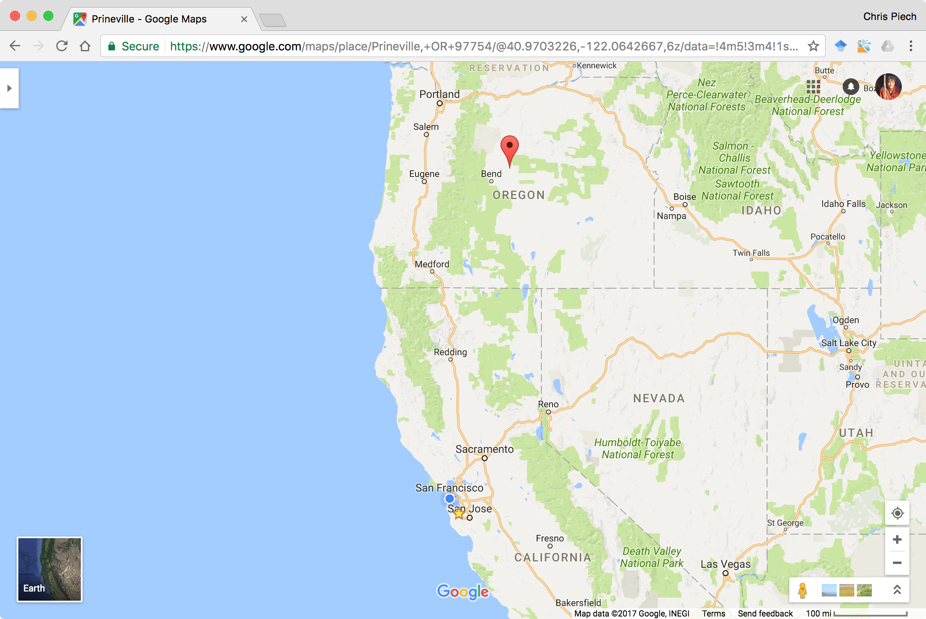
Facebook’s closest datacenter is here
I am here

Slide 43
Face Book Server
The Internet

Slide 44
Face Book Server
The Internet
Get status for piech@cs.stanford.edu

Slide 45
Face Book Server
The Internet

Slide 46
Face Book Server
The Internet

Slide 47
teaching
Face Book Server
The Internet

Slide 48
teaching
Face Book Server
The Internet

Slide 49
Face Book Server
The Internet

Slide 50
Many programs can connect to the same server

Slide 51
The Internet
Facebook datacenter
RESPONSE
REQUEST
REQUEST
Your mom’s computer
(linux shell)
RESPONSE
“Server”
Tate Ole Keko’s computer (facebook.com)
Chris’ phone (facebook app)
“Client”
“Client”
“Client”

Slide 52
Most of the Internet
Aka “the frontend”
Aka “the backend”
Server / Clients
Aka “the cloud”
Aka “the GUI”
Aka “the database”

Slide 53
There are two types of internet programs. Servers and Clients

Slide 54
First, the server

Slide 55
A Server’s Simple Purpose
Request
someRequest
String
serverResponse
Server

Slide 56
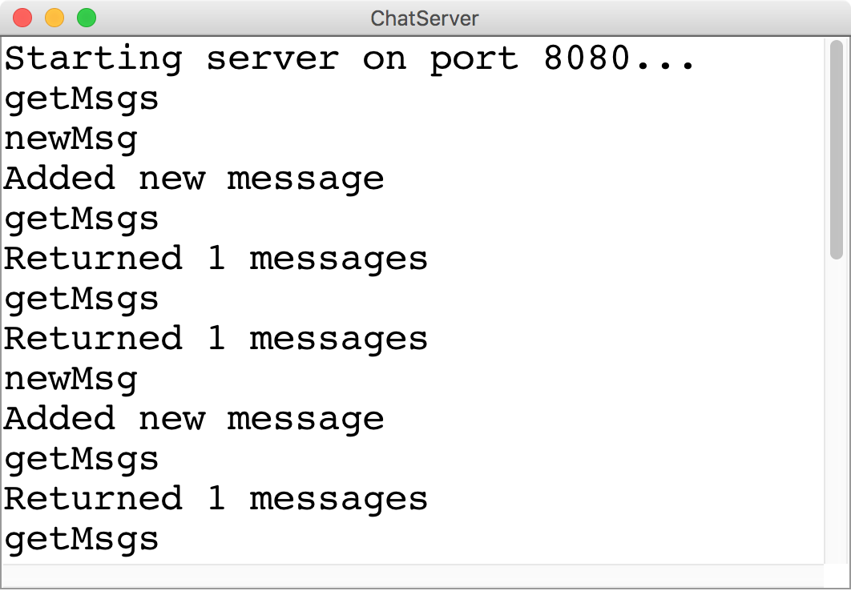
A Server’s Simple Purpose
Request
someRequest
String
serverResponse

Slide 57
Servers on one slide
public String requestMade(Request request) {
// server code goes here
}
1
2
// make a Server object
private SimpleServer server
= new SimpleServer(this, 8000);
3
public void run(){
// start the server
server.start();
}

Slide 58
A Server’s Simple Purpose
public String requestMade(Request request) {
// server code goes here
}
1
2
// make a Server object
private SimpleServer server
= new SimpleServer(this, 8000);
3
public void run(){
// start the server
server.start();
}

Slide 59
What is a Request?
/* Request has a command */
String command;
/* Request has parameters */
HashMap<String,String> params;
Request request
// methods that the server calls on requests
request.getCommand();
request.getParam(key); //returns associated value

Slide 60
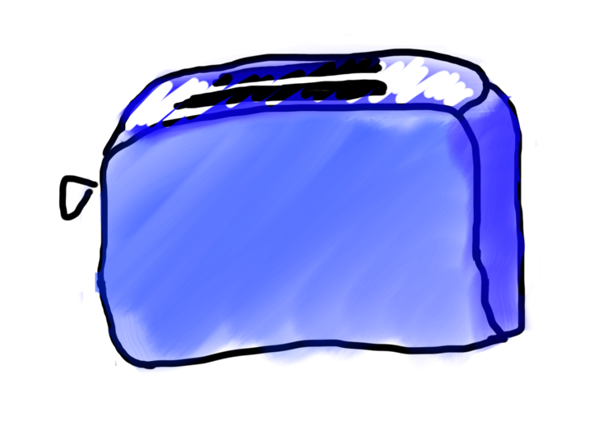
Requests are like Remote Method Calls
Server has a bunch of discrete things it can do
Server
makeToast
blendIngedients

Slide 61
Requests are like Remote Method Calls
Server has a bunch of discrete things it can do
Server
getStatus
addUser

Slide 62
Requests are like Remote Method Calls
Server
getStatus
addUser

Slide 63
Requests are like Remote Method Calls
request.getCommand();
=> ”getStatus”
Server
getStatus
addUser

Slide 64

Requests are like Remote Method Calls
To make toast, I need a parameter which is the kind of bread
getStatus

Slide 65
Requests are like Remote Method Calls
I was given a parameter!
getStatus

Slide 66
Requests are like Remote Method Calls
request.getParam(“userName”)
getStatus

Slide 67

Requests are like Remote Method Calls
getStatus

Slide 68

Requests are like Remote Method Calls
cpiech
getStatus

Slide 69


Requests are like Remote Method Calls
teaching

Slide 70

public String requestMade(Request request) {
String cmd = request.getCommand();
if(cmd.equals(“getStatus”)) {
String user = request.getParam(“userName”);
String status = runGetStatus(user);
}
...
}
return status;
.toString()???

Slide 71

Requests are like Remote Method Calls

Slide 72
Requests are like Remote Method Calls

Slide 73
Requests are like Remote Method Calls

Slide 74
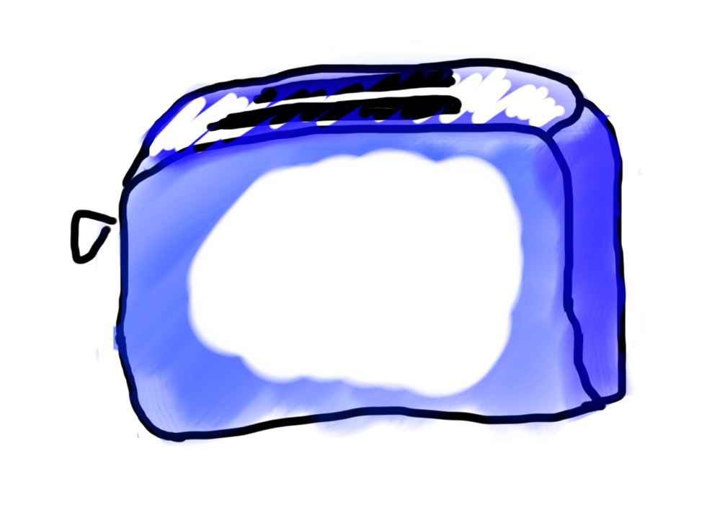
Requests are like Remote Method Calls

Slide 75

Requests are like Remote Method Calls

Slide 76
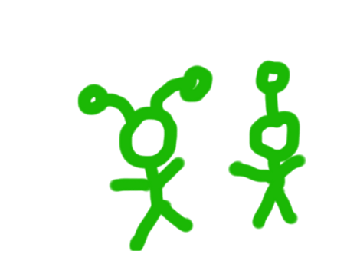
Requests are like Remote Method Calls

Slide 77
What is a Request?
/* Request has a command */
String command;
/* Request has parameters */
HashMap<String,String> params;
Request request
// methods that the server calls on requests
request.getCommand();
request.getParam(key); //returns associated value

Slide 78
A Server’s Simple Purpose
public String requestMade(Request request) {
// server code goes here
}
1
2
// make a Server object
private SimpleServer server
= new SimpleServer(this, 8000);
3
public void run(){
// start the server
server.start();
}

Slide 79
A Server’s Simple Purpose
public String requestMade(Request request) {
// server code goes here
}
1
2
// make a Server object
private SimpleServer server
= new SimpleServer(this, 8000);
3
public void run(){
// start the server
server.start();
}

Slide 80
What is a Port?

Slide 81
Servers on one slide
public String requestMade(Request request) {
// server code goes here
}
1
2
// make a Server object
private SimpleServer server
= new SimpleServer(this, 8000);
3
public void run(){
// start the server
server.start();
}

Slide 82
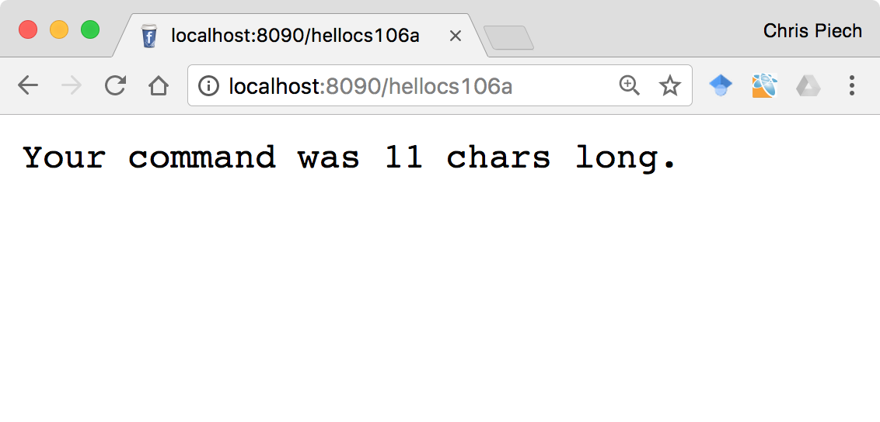
Echo Server

Slide 83
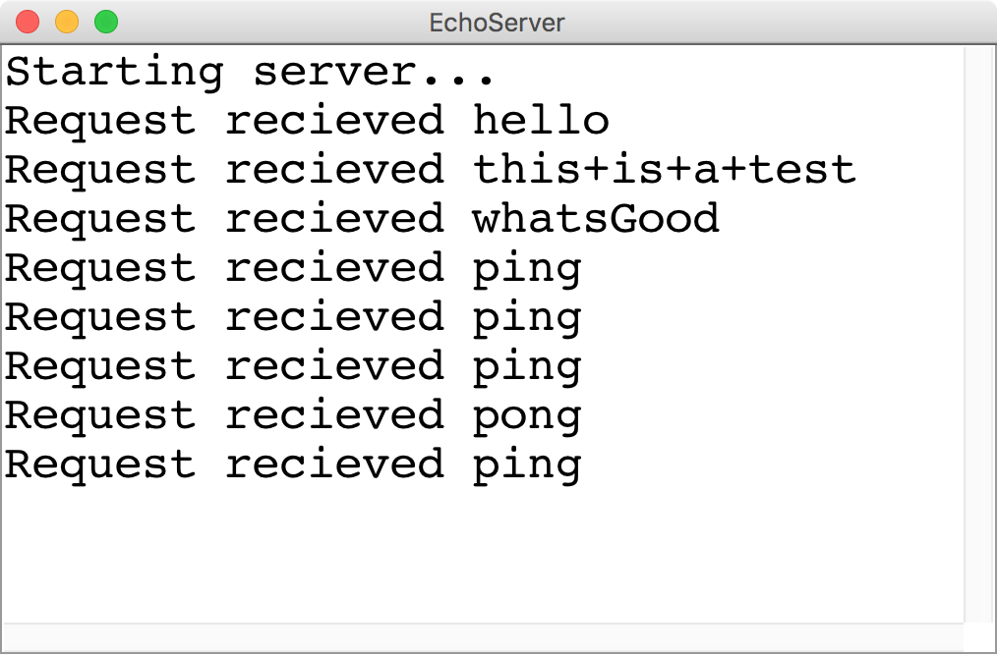
Echo Server
Request
Any Request
String
Length of the cmd

Slide 84
There are two types of internet programs. Servers and Clients

Slide 85
Then, the client

Slide 86
A Clients’s Purpose
1. Interact with the user
2. Get data from its server
3. Save data to its server

Slide 87
Clients on one slide
try {
// 1. construct a new request
Request example = new Request("getStatus");
// 2. add parameters to the request
example.addParam("name", "chris");
// 3. send the request to a computer on the internet
String result = SimpleClient.makeRequest(HOST, example);
} catch(IOException e) {
// The internet is a fast and wild world my friend
}

Slide 88
Clients on one slide
try {
// 1. construct a new request
Request example = new Request("getStatus");
// 2. add parameters to the request
example.addParam("name", "chris");
// 3. send the request to a computer on the internet
String result = SimpleClient.makeRequest(HOST, example);
} catch(IOException e) {
// The internet is a fast and wild world my friend
}

Slide 89
Clients on one slide
try {
// 1. construct a new request
Request example = new Request("getStatus");
// 2. add parameters to the request
example.addParam("name", "chris");
// 3. send the request to a computer on the internet
String result = SimpleClient.makeRequest(HOST, example);
} catch(IOException e) {
// The internet is a fast and wild world my friend
}

Slide 90
Clients on one slide
try {
// 1. construct a new request
Request example = new Request("getStatus");
// 2. add parameters to the request
example.addParam("name", "chris");
// 3. send the request to a computer on the internet
String result = SimpleClient.makeRequest(HOST, example);
} catch(IOException e) {
// The internet is a fast and wild world my friend
}

Slide 91
Clients on one slide
try {
// 1. construct a new request
Request example = new Request("getStatus");
// 2. add parameters to the request
example.addParam("name", "chris");
// 3. send the request to a computer on the internet
String result = SimpleClient.makeRequest(HOST, example);
} catch(IOException e) {
// The internet is a fast and wild world my friend
}

Slide 92
Clients on one slide
try {
// 1. construct a new request
Request example = new Request("getStatus");
// 2. add parameters to the request
example.addParam("name", "chris");
// 3. send the request to a computer on the internet
String result = SimpleClient.makeRequest(HOST, example);
} catch(IOException e) {
// The internet is a fast and wild world my friend
}

Slide 93
Clients on one slide
try {
// 1. construct a new request
Request example = new Request("getStatus");
// 2. add parameters to the request
example.addParam("name", "chris");
// 3. send the request to a computer on the internet
String result = SimpleClient.makeRequest(HOST, example);
} catch(IOException e) {
// The internet is a fast and wild world my friend
}

Slide 94
Clients on one slide
try {
// 1. construct a new request
Request example = new Request("getStatus");
// 2. add parameters to the request
example.addParam("name", "chris");
// 3. send the request to a computer on the internet
String result = SimpleClient.makeRequest(HOST, example);
} catch(IOException e) {
// The internet is a fast and wild world my friend
}

Slide 95
Time for a little chat

Slide 96
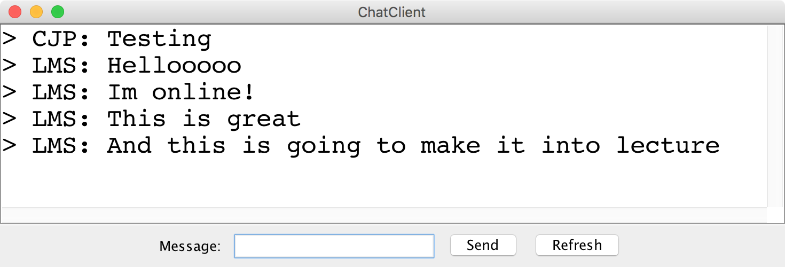
Chat Server and Client

Slide 97
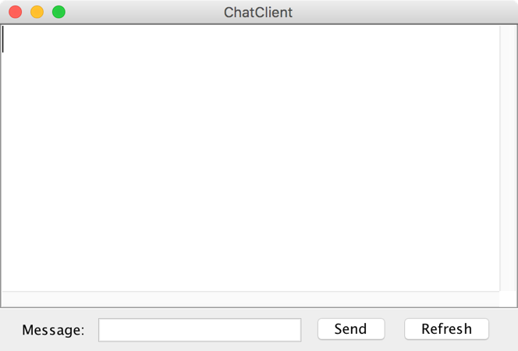
history = [
]
addMsg
msg = C: Hello world
Chat Client
Chat Client
Send
Hello world
Send

Slide 98
history = [
C: Hello world
]
getMsgs
index = 0
Chat Client
Chat Client
Send
Send

Slide 99
history = [
C: Hello world
]
[C: Hello world]
Chat Client
Chat Client
> C: Hello world
> C: Hello world
Send
Send

Slide 100
history = [
C: Hello world
]
addMsg
msg = B: Im here too
Chat Client
Chat Client
> C: Hello world
> C: Hello world
Im here too
Send
Send

Slide 101
history = [
C: Hello world,
B: Im here too
]
getMsgs
index = 1
Chat Client
Chat Client
> C: Hello world
> C: Hello world
Send
Send

Slide 102
history = [
C: Hello world,
B: Im here too
]
[B: Im here too]
Chat Client
Chat Client
> C: Hello world
> C: Hello world
> B: Im here too
> B: Im here too
Send
Send

Slide 103
Chat Server
addMsg
msg = text
Chat Server
getMsgs
index = startIndex

